Slide 1

Mining in Big Data:
from Social Networks to Artificial Intelligence
Yulong Gu
Department of Computer Science and Technology Tsinghua University, Beijing, 100084, China
Ph.D. candidate guyulongcs@gmail.com

Slide 2
Research Interests
Data Mining
Machine Learning
Natural Language Processing
Recommender Systems
Social Networks
AI

Slide 3
Research
Social Networks:
User Profiling
Home Location Identification[1]: Probabilistic Model
Recommender Systems
Event Recommendation[2]: Context-Aware Matrix Factorization
Group Recommendation[3]: Hybrid Neural Collaborative Filtering
Artificial Intelligence:
Knowledge Graph
Relation Extraction[4]: Understanding texts in Web
Activity Sensing
Activity Recognition[5]: Conditional Random Fields Model

Slide 4
Projects
2013-2016
National Ordinary College Enrollment System in China
30+ provinces, 3000+ universities, several million students
2010-2011
Intelligent Embedded Service System based on Wifi and GPS
Voice-Map application on Android
2010-2011
Digital Rights Management System applied for Mobile Internet
Multimedia Digital Rights Management

Slide 5
Internship
2013.07-2015.07
Microsoft Research Asia
Knowledge Mining Group
Build Knowledge Graph from texts using Data Mining, Machine Learning, NLP
2012.04-2012.07
Sougou
Web Search Research Group
Improve the quality of search engine
2011.07-2012.03
Baidu
Data Mining and Anti-Spam Team in Tieba
research and develop the anti-spam system in Tieba

Slide 6
Competition
First Prize in CCF Big Data Innovation Contest
Enterprise Mobile Intelligent Information System
Enterprise Search Engine System
Enterprise Question-Answer System based on database
First Prize in China Undergraduate Mathematical Contest in Modeling, Beijing
Second Prize in Mathematical Contest in Modeling
First Prize in China Water Robot Contest
First Prize in RoboCup open contest of the China Robot Contest

Slide 7
Outline
1. Home Location Profiling
HLGPS: A Home Location Global Positioning System in Location-Based Social Networks[1]
2. Event Recommendation
Context Aware Matrix Factorization for Event Recommendation in Event-based Social Networks[2]
3. Group Recommendation
Deep Neural Networks for Group Recommendation in Event-based Social Networks[3]
4. Relation Extraction
Towards Accurate Relation Extraction from Wikipedia[4]

Slide 8
HLGPS: A Home Location Global Positioning System in Location-Based Social Networks
ICDM 2016
Yulong Gu

Slide 9


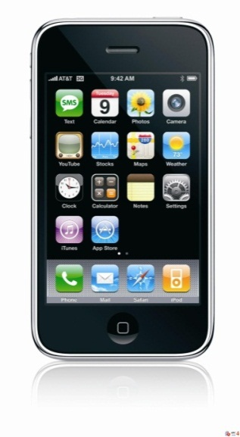
Location-Based Social Networks
Social Networks:
Facebook, Twitter, Google+
Facebook: 1.18 billion monthly active users(August 2015)
Location-Based Social Networks
Foursquare, Facebook Place…
Social Networks
Location

Slide 10
Motivation
Home Location Application :
Personalized search
Targeted advertisement
News recommendation

Slide 11
Related Work
Content Based Approach
texts(tweets) --> words --> home location
Check-in Based Approach
Average KDD11
Maxvote Ubicomp12
Hierarchical Clustering Infocom14
Influence model KDD12

Slide 12
Challenge of Home Location Identification
Few users provide their home locations
Twitter: 16%
(2) Check-ins and friends can be far away
(3) many users do not have any check-in data
20% users have used check-in

Slide 13
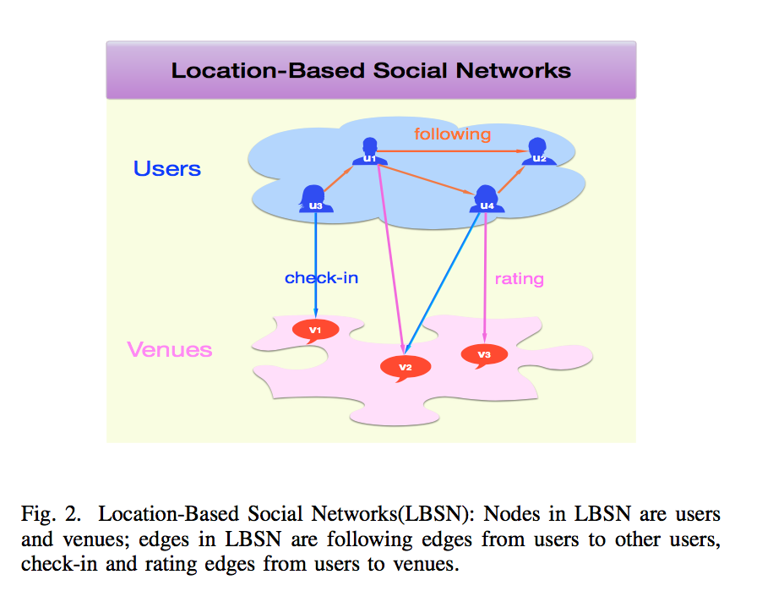
Information
Friendships, Check-in, Rating

Slide 14
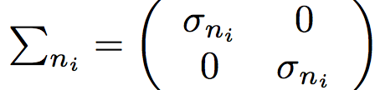
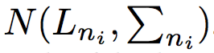
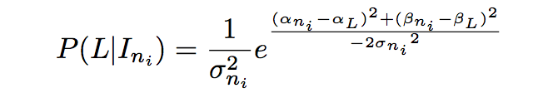
Influence Model of Nodes on Geographic:

Slide 15
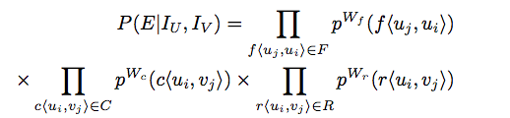
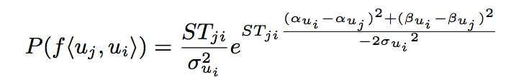
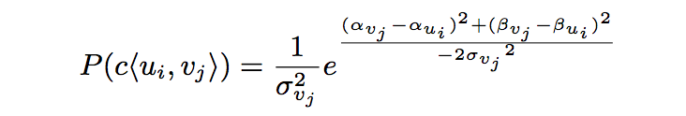
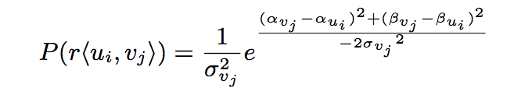
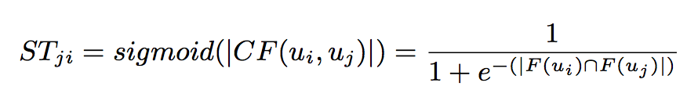
Influence Probabilistic Model

Slide 16
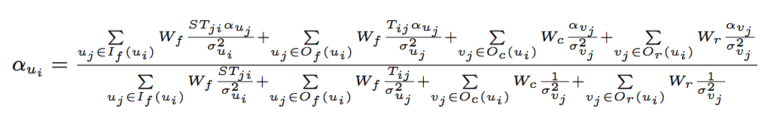
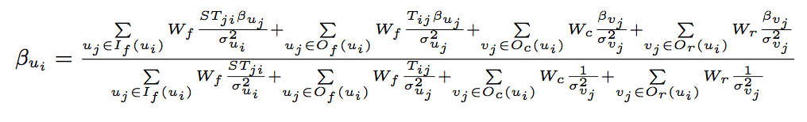
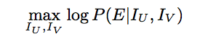
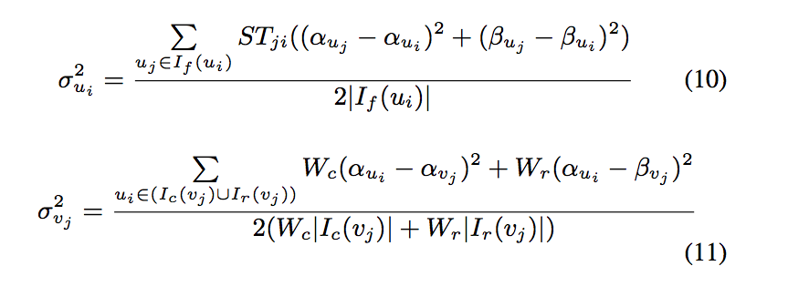
Solution

Slide 17
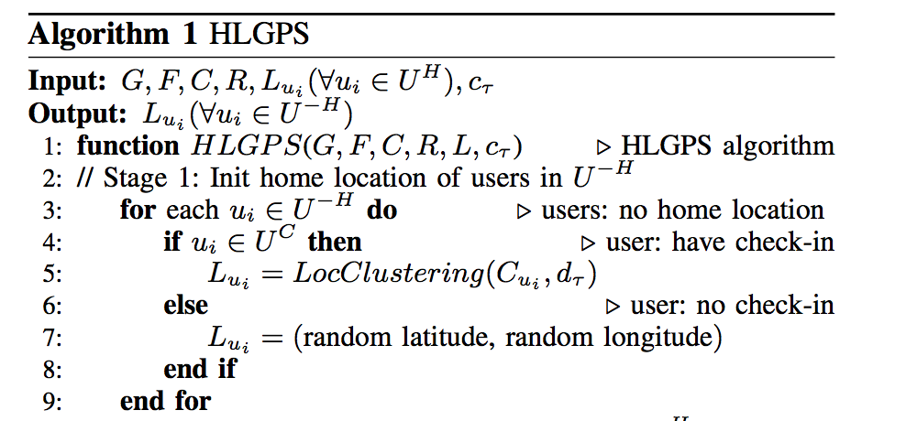
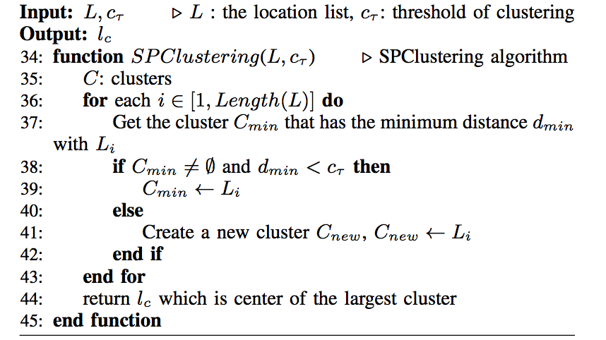
Algorithm
Stage 1: Clustering

Slide 18
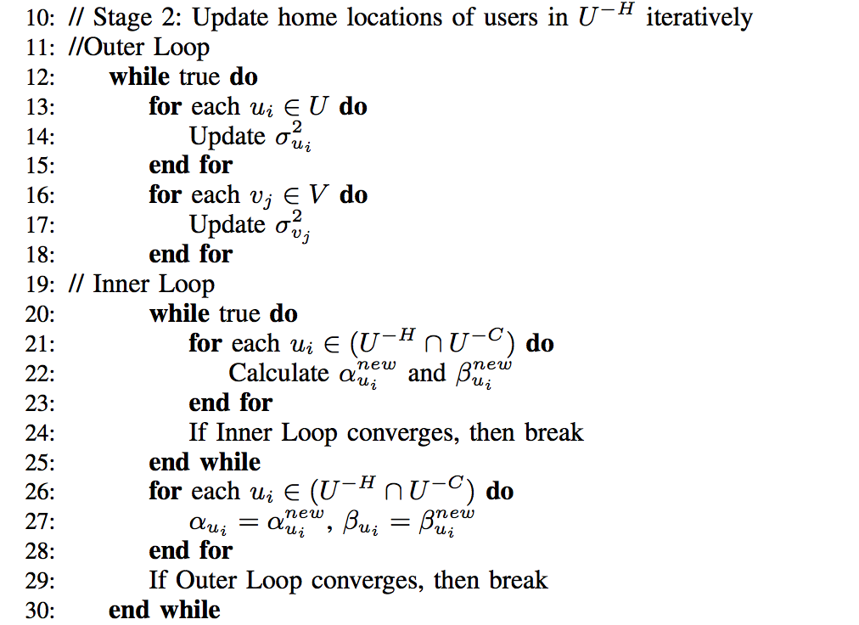
Algorithm
Stage 2: Global Iteration

Slide 19
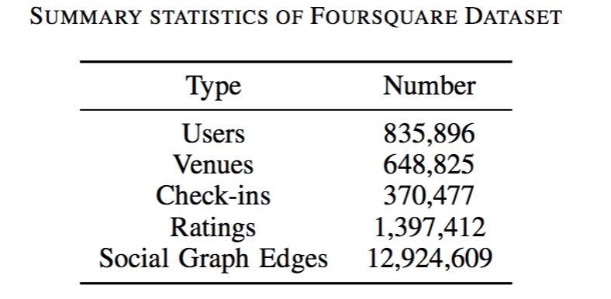
Dataset
A widely used and publicly available Foursquare dataset

Slide 20
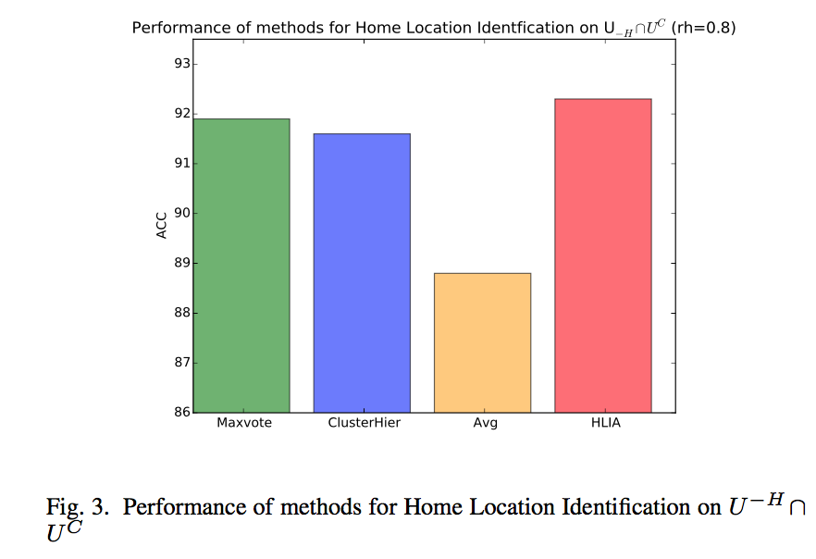
Clustering
Maxvote, ClusterHier, Avg can only predict home location of users who have check-in data:16.7%
HLIA: accuracy of 92.1% when average check-in number is only about 2.7 and achieves the best performance

Slide 21
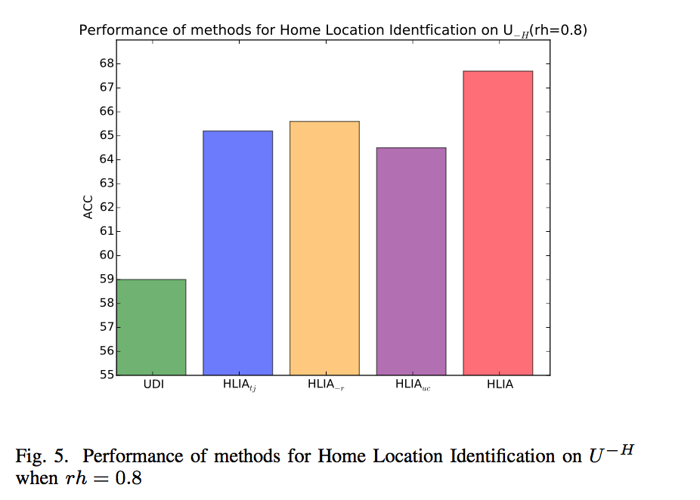
HLIA
Accuracy of 67.7% when only 16.7% have check-in data and 20% of users don’t have home location
Outperforming stat-of-the-art methods by about 14.7%

Slide 22
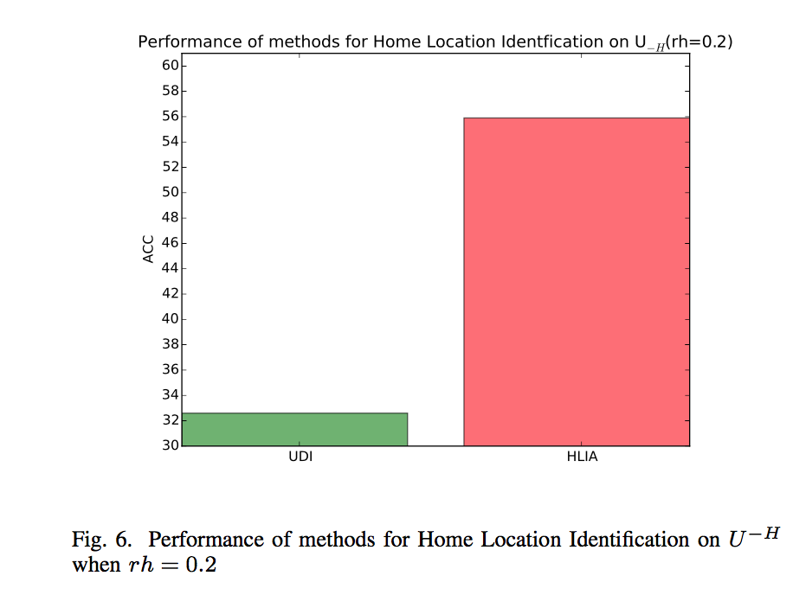
Sparse
HLIA significantly outperforms UDI by 71.5%.
HLIA outperforms UDI even more when more users don’t have home location.

Slide 23
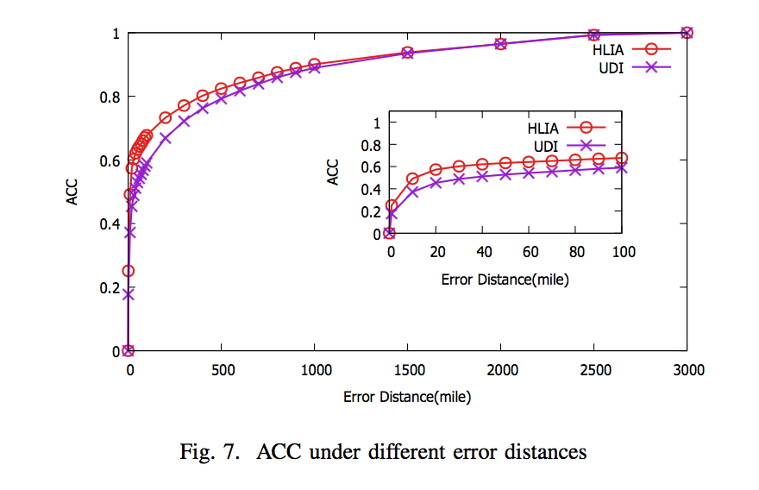
ACC under different error distances

Slide 24
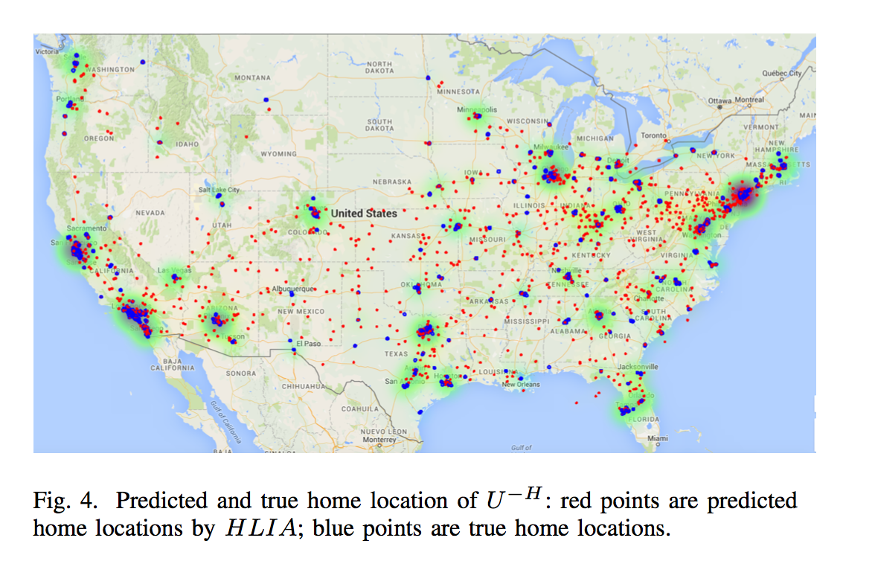

Slide 25
Conclusion
We firstly propose a trust-based probabilistic model TSU
We firstly propose the idea of using social trust for HLI
We firstly propose the idea of using rating data for HLI
HLIA outperforms state-of-the-art methods greatly

Slide 26
Conclusion
We firstly propose a trust-based probabilistic model TSU.
We firstly propose the idea of using social trust for HLI.
We firstly propose the idea of using rating data for HLI.
HLIA outperforms state-of-the-art methods greatly.

Slide 27
Future Works
Use time information for Home Location Identification
Improve Location-Based Services using HLIA
Protect privacy of users in social networks

Slide 28
Context Aware Matrix Factorization for Event Recommendation in Event-based Social Networks
WI 2016
Yulong Gu

Slide 29
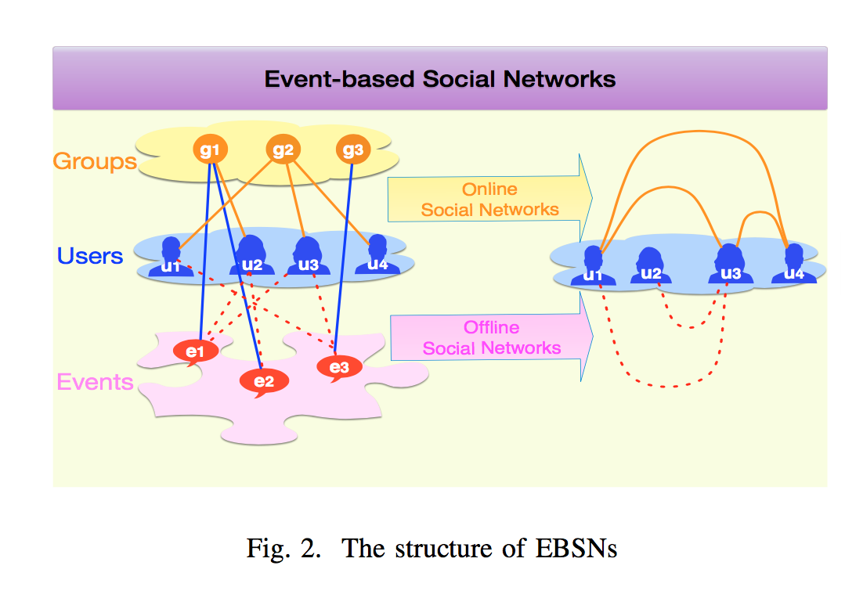


Event-based Social Networks
Online Interations + Offline Events

Slide 30
Recommender Systems
Contend-based Recommender Systems:
Idea: recommend items similar to the ones that the users have preferred in the past
Collaborative filtering Recommender Systems：
Idea: evaluating items through opinions of other people
Methods:
Memory-based methods: using whole user-item matrix
User-based
item-based
Model-based methods：using latent factors
Matrix Factorization

Slide 31
Challenge of Event Recommendation Problem
Extreme sparsity:
events have short life time
Serious cold-start problem:
New events are RSVPed by few users
Implicit feedbacks:
there is no explicit rating data

Slide 32
Event Recommendation in EBSNs
Bayesian matrix factorization[6]
SVD with Multi-Factor Neighborhood model[7]
Learn-to-rank model[8]

Slide 33
Idea of Model
Matrix Factorization:
model implicit feedbacks which are the RSVPs from users to events
Linear contextual feature model:
model explicit contextual features

Slide 34
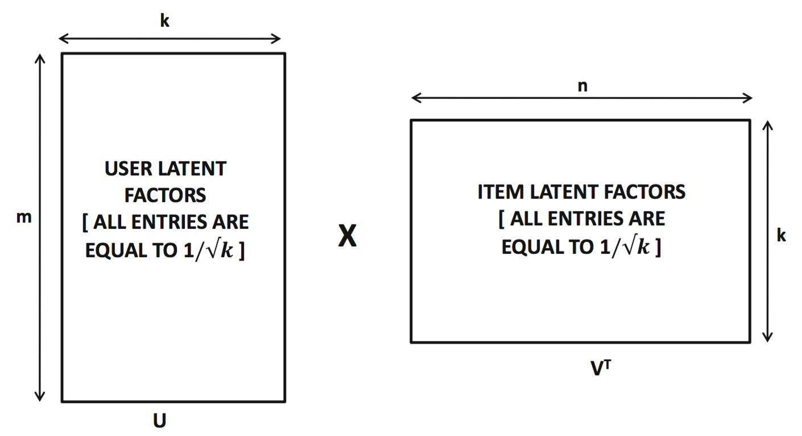
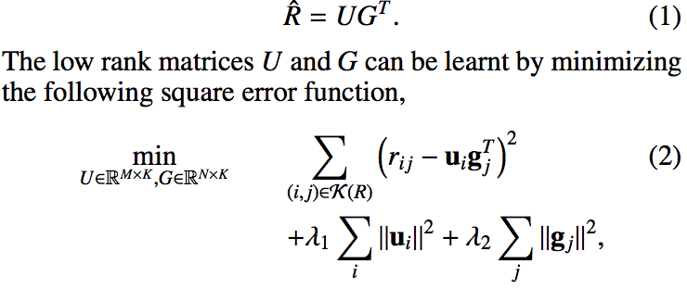
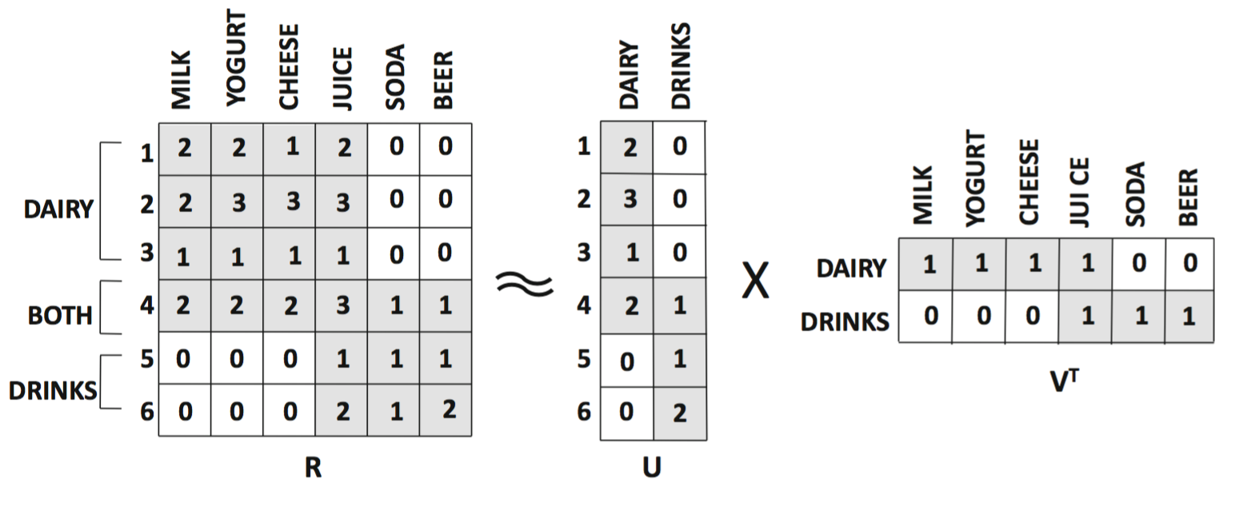
Matrix Factorization
Matrix Factorization
Similar Method:
SVD++, SVD feature
Factorization Machines

Slide 35
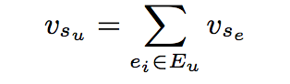
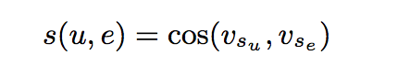
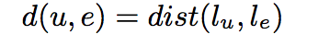
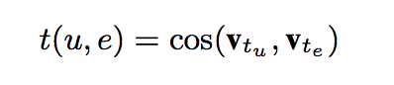
Contextual Features
Semantic:
semantic similarity between user and event
Spatial:
spatial preference of users when attending events
distance between user and event:
Temporal:
temporal preference of users when attending events

Slide 36
Contextual Features
User:
count of attended events
ratio of attended events of the same group
Event:
count of similar events the user has attended
Group:
group preference of users
Social:
count of online friends who have RSVPed the event
count of offline friend who have RSVPed the event

Slide 37
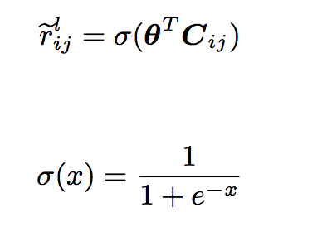
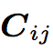
Linear contextual feature model
contextual features vector

Slide 38
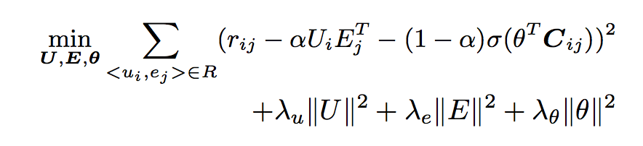
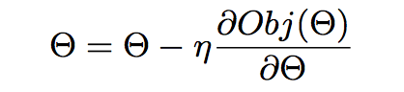
AlphaMF Model
Formulation:
Optimization Criterion:
Parameter Learning:
stochastic gradient descent(SGD)

Slide 39
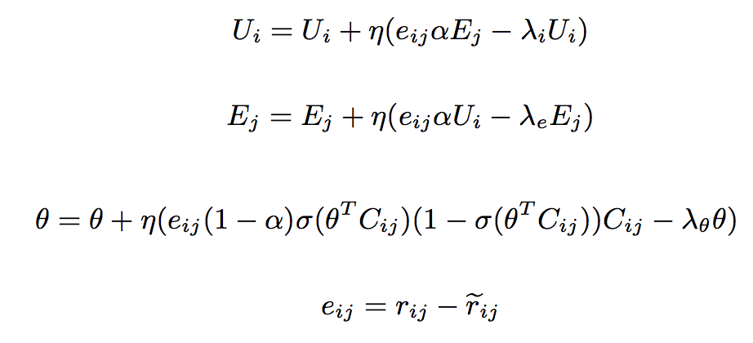
Parameters Updating in SGD

Slide 40
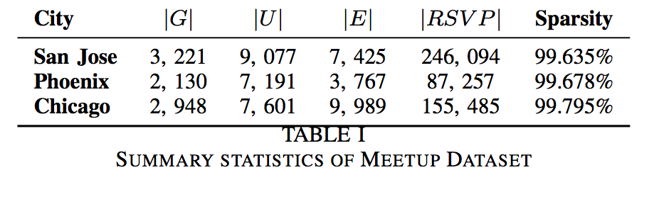
Dataset
Meetup Dataset:
Group, User, Event, RSVP

Slide 41
Baseline Methods
MF[7]:
Matrix Factorization
BPR-MF[9]:
Bayesian Personalized Ranking based Matrix Factorization
C-MDM[10]:
linear classification model exploiting semantic, temporal, and spatial features
L-MC[11]:
linear model that uses multiple contextual features

Slide 42
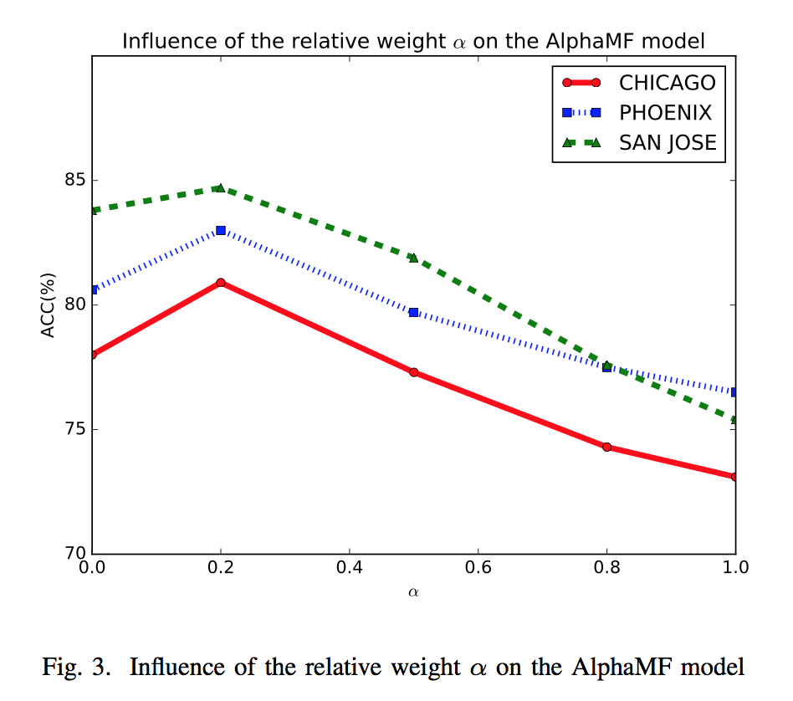
Influence of the relative weight

Slide 43
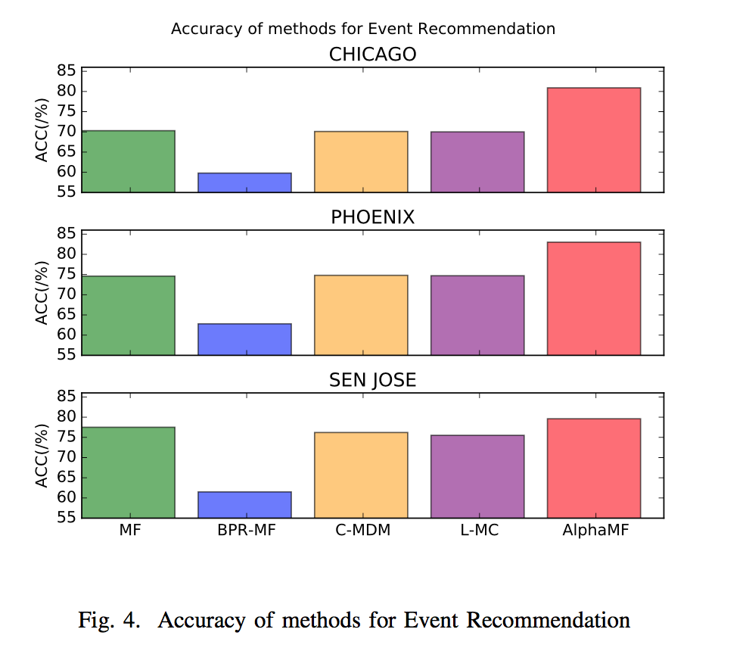
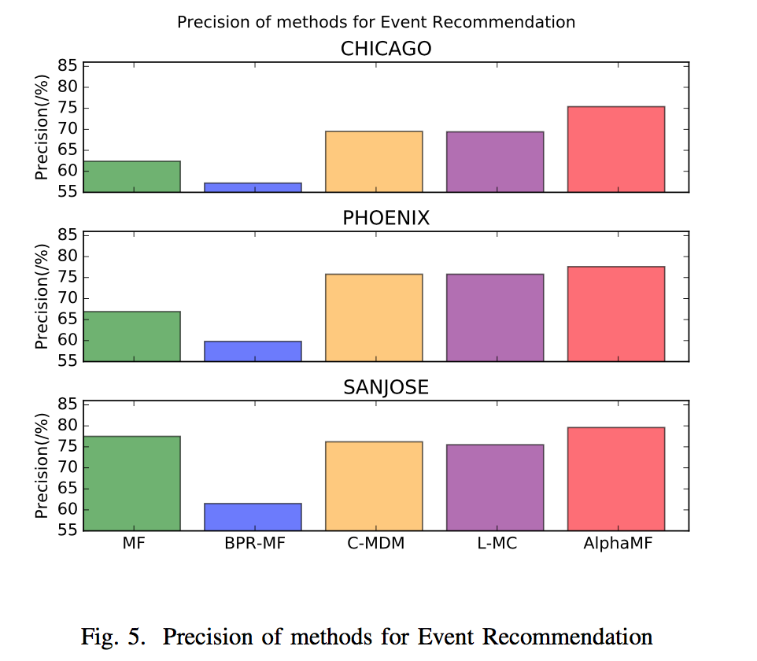
Comparison of models for Event Recommendation
Accuracy of AlphaMF:80.9%, 83.0%, 84.7%
outperforming the strongest state-of-the-art method by more than 11%

Slide 44
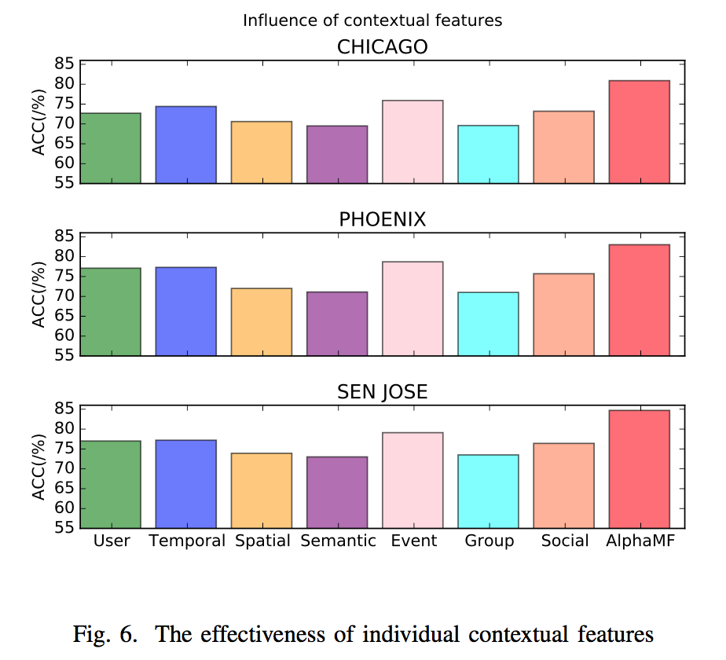
Analysis of Contextual Features
Event, User, Temporal > Social, Spatial, Group, Semantic

Slide 45
Conclusion
We have proposed a Context Aware Matrix Factorization model called AlphaMF for the event recommendation problem.
We have conducted extensive experiments, proved the effectiveness of AlphaMF shown that AlphaMF significantly outperforms state-of-the-art methods by 11%.

Slide 46
Discussion of AlphaMF
Outstanding performance:
significantly outperforms state-of-the-art methods
An unified model:
jointly models implicit feedbacks and explicit contextual signals
Highly extensible:
New type of contextual features can be added into the model easily
A flexible framework:
can be widely used in various context aware recommendation problems.

Slide 47
Deep Neural Networks for Group Recommendation in Event-based Social Networks
Yulong Gu

Slide 48
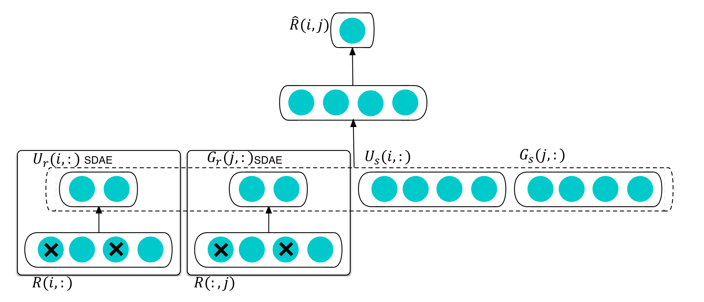
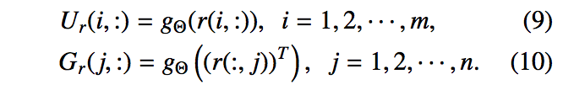
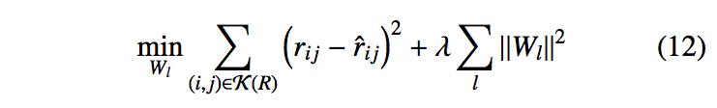
HNCF: Hybrid Neural Collaborative Filtering

Slide 49
Dataset
Meetup Dataset:
Group, User, Event, RSVP

Slide 50
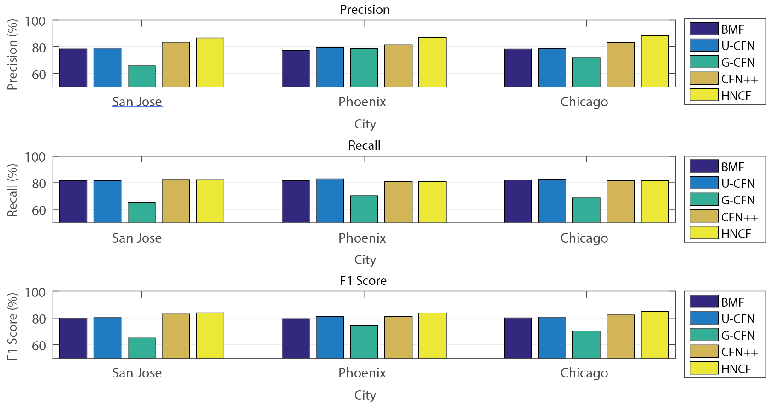

Slide 51
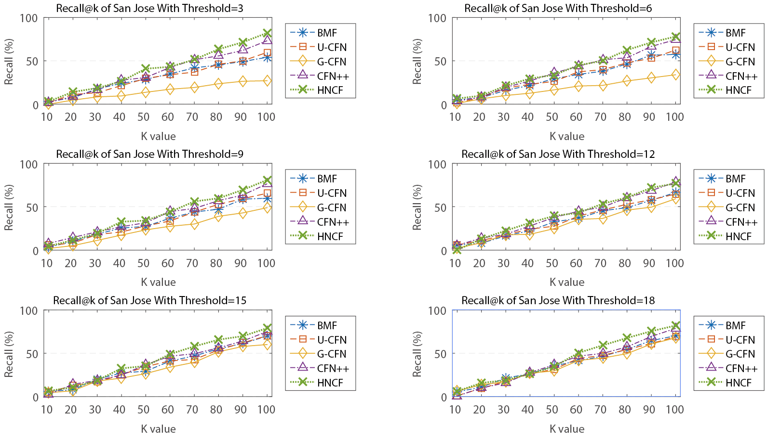
Thr: Only the number of groups that users have participated is greater than Thr, then the user will be used for training the model. When Thr is smaller, the dataset is sparser.
HCNF will be more superior for sparse dataset!

Slide 52
Conclusion
We proposed a hybrid neural network based collaborative filtering model called HNCF to tackle the Group Recommendation problem in social networks.
HNCF is a unified model that connects SDAE based collaborative filtering model with rich side information in social networks.
Extensive experiments on a large real-world EBSN dataset demonstrate that HNCF significantly outperforms state-of-the-art methods.

Slide 53
Towards Accurate Relation Extraction
from Wikipedia
WI 2016
Yulong Gu

Slide 54
Preliminary
What’s is Knowledge?
Facts of the world
Example: Barack Obama was born on August 4, 1961.
How Knowledge is represented?
triplets: (head entity, relationship, tail entity)
Example: (Barack Obama, DateOfBirth, 1961/08/04)
Knowledge base:
Knowledge base: store triplets
Example: Google Knowledge Graph, DBpedia, Freebase
What can Knowledge base be used for?
Search Engine, Question Answering, Intelligent Personal Assistants

Slide 55
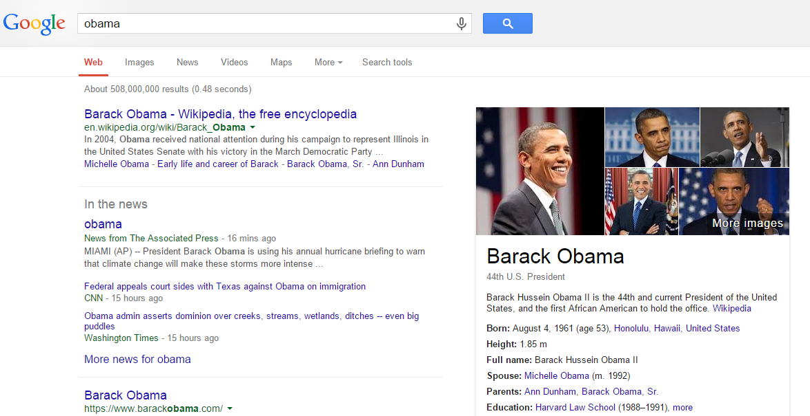
Google Knowledge Graph

Slide 56
Motivation
However, the KBs we have are far from completion and Imperfect.
Recent Study on Freebase by Google Research (WWW 2014) shows that 71% Persons have no known place of birth, 94% have no known parents, and 99% have no known ethnicity.
Therefore, we need to explore methods on building knowledge base.
Here, we focus on relation extraction in texts(Wikipedia).
Example:
https://en.wikipedia.org/wiki/Annabelle_Chvostek
Born in Toronto, she is the daughter of Canadian television producer Milan Chvostek (The Nature of Things) and journalist Isobel Warren.
ChildOf(Annabelle_Chvostek, Milan_Chvostek)
ChildOf(Annabelle_Chvostek, Isobel Warren)

Slide 57
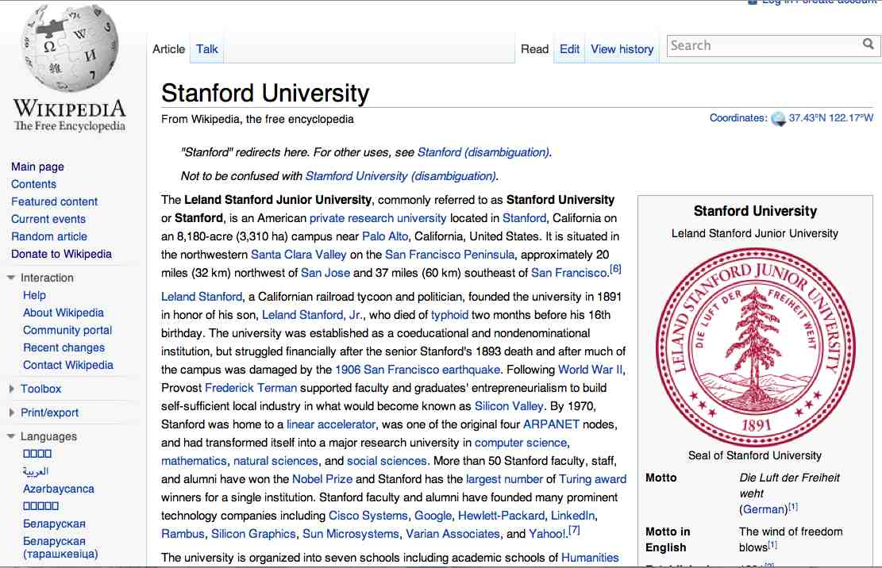
Extracting Knowledge from Wikipedia
The Leland Stanford Junior University, commonly referred to as Stanford University or Stanford, is an American private research university located in Stanford, California … near Palo Alto, California… Leland Stanford…founded the university in 1891
Stanford LOC-IN California
Stanford FOUNDED-IN 1891
Stanford FOUNDER Leland Stanford

Slide 58
Why do we choose Wikipedia?
Huge Knowledge:
30 million articles in 287 languages
over 4.4 million in English
Accurate Source:
Unique Identifiers:

Slide 59
Existing methods
Supervised learning methods[12]
Idea: using lexical and syntactic features on labeled data
Drawback: hard to scale to new relations,
labeling data requires huge amount of labor
Boosting methods[13]
Idea: bootstrapping the produces of identifying tuples and patterns using some seeds
Drawback: requirement of duplication of presence of the seeds which is rare in Wikipedia,
many parameters need to be tuned,
semantic drift caused by small number of seeds.
Distant Supervision[14]
Idea: using a large knowledge base to provide distant supervision for relation extraction
Drawback: Recall is still not satisfying

Slide 60
Our Approach
Entity-Level Relation Extraction
Architecture of Athena
Features in Athena
Relation Extraction Model

Slide 61
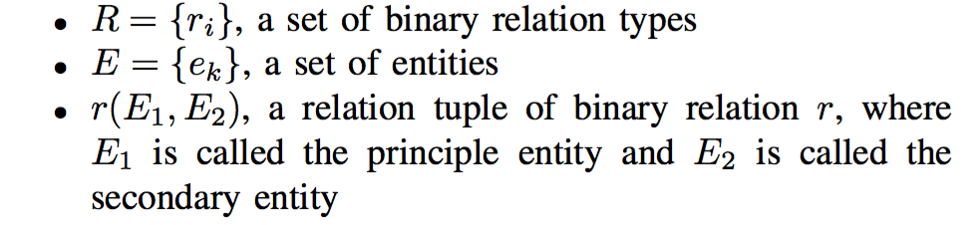
Entity-Level Relation Extraction
Entity-Level Relation Extraction:
Example:
http://en.wikipedia.org/wiki/Bill_Gates
Gates married Melinda French on January 1, 1994.
Spouse(Bill_Gates, Melinda French)

Slide 62


Distant Supervision
(Albert Einstein, Ulm)
(Mitt Romney, Detroit)
(Barack Obama, Honolulu)
Person | PlaceOfBirth
Barack Obama | Honolulu
Mitt Romney | Detroit
Albert Einstein | Ulm
Nikola Tesla | Smiljan
… | …
“Barack Obama was born on August 4, 1961 at … in the city of Honolulu ...”
“Born in Honolulu, Barack Obama went on to become…”
…

Slide 63
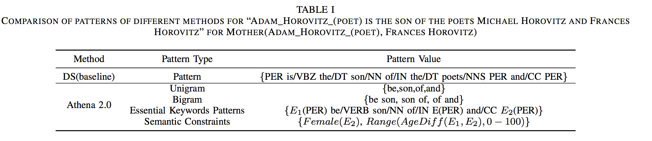
Features in Athena

Slide 64

Architecture of Athena

Slide 65
Essential Keyword Patterns
Essential Keywords:
essential words related with target relation type
N-Gram Patterns:
N-Gram of Essential Keywords for target relation type
Essential Keyword Patterns:
patterns consisted of entities and essential keywords words
Example: “E1 (PER) be born to E2 (PER)”

Slide 66

Learning of Essential Keyword Patterns

Slide 67
Semantic Constraints Mining
Association Rule Mining in Knowledge base:
AMIE[16] mined 902 rules
We selected 242 rules that have PCA confidence > 0.8

Slide 68

Semantic Patterns
Semantic Patterns = Essential Keyword Patterns + Semantic Constraints

Slide 69

Relation Extraction Model
Markov Logic Networks[17]
Athena constructed the formulaes in MLN using extracted features.
x can be all the features extracted from the entity pairs
q are the relationship queries

Slide 70


Formulaes in MLN
Example:
Relation type: Mother
Essential Keyword Pattern:
formula:
Semantic Constraints:

Slide 71
Experiments
Data
Patterns
Relation Extraction
Summary

Slide 72

Data
Text: Wikipedia
Knowledge base: Freebase
Relation Types: 16 most popular relation types

Slide 73
Baseline methods
DS(baseline)[14] : Distant Supervision
CRF[17]: Conditional random fields
KBP: state-of-the-art method called RelationFactory in KBP completion in TAC

Slide 74
Experiment Results
Analysing of Essential Keyword Patterns
Analysing of Semantic Constraints
Comparison With Baseline Methods

Slide 75

Analysing of Essential Keyword Patterns
Essential Keyword Patterns improved the recall by 182.2% but the precision decreases by 16.9%

Slide 76

Analysing of Semantic Constraints
Athena 2.0 significantly outperforms DS(baseline) by increase the recall by 253.4% and the precision by 8.2%
Semantic Constraints contributes 30.4%, 25.2%, 27.8% increase in precision, recall and F1 respectively.

Slide 77

Comparison With Baseline Methods
Athena 2.0 can increase the F1 by 63.6%, 71.6%, 10.2% than the baseline methods DS(baseline), CRF, KBP respectively.
Semantic Constraints contributes 7.5%, 7.6%, 7.6% increase in precision, recall and F1 respectively.
Athena 2.0 outperforms the three baseline methods leveraging Semantic Patterns.

Slide 78
Conclusion
We have proposed Semantic Patterns and applied them to relation extraction.
We have proposed a novel framework called Athena 2.0 which performs Entity-Level Distant Supervision in Wikipedia leveraging Semantic Patterns.
We have conducted extensive experiments, proved the effectiveness of Semantic Patterns in relation extraction and demonstrated that Athena 2.0 outperforms existing methods greatly.

Slide 79
Reference
[1] Yulong Gu, Yuan Yao, Weidong Liu, and Jiaxing Song. "HLGPS: A Home Location Global Positioning System in Location-Based Social Networks." 2016 The IEEE International Conference on Data Mining(ICDM 2016). IEEE, 2016.
[2] Gu, Yulong, Jiaxing Song, Weidong Liu, Yuan Yao and Lixin Zou. "Context Aware Matrix Factorization for Event Recommendation in Event-based Social Networks." 2016 IEEE/WIC/ACM International Conference on Web Intelligence and Intelligent Agent Technology (WI-IAT 2016). Vol. 1. IEEE, 2016.
[3] Yulong Gu, Lixin Zou, Weidong Liu, and Jiaxing Song. Deep Neural Networks for Group Recommendation in Event-based Social Networks. Submitted.
[4] Gu, Yulong, Jiaxing Song, Weidong Liu, Lixin Zou and Yuan Yao. "Towards Accurate Relation Extraction from Wikipedia." 2016 IEEE/WIC/ACM International Conference on Web Intelligence and Intelligent Agent Technology (WI-IAT 2016). Vol. 1. IEEE, 2016.
[5] Gu, Yulong, Mengjia Feng, Yuan Yao, Weidong Liu, and Jiaxing Song. “We Know What You are doing or going to do: Towards Accurate Human Activities Sensing.” 2016 25th International Conference on Computer Communication and Networks (ICCCN 2016). IEEE, 2016.
[6] Z. Qiao, P. Zhang, Y. Cao, C. Zhou, L. Guo, and B. Fang, “Combining heterogenous social and geographical information for event recommendation,” in Twenty-Eighth AAAI Conference on Artificial Intelligence, 2014.
[7] R. Du, Z. Yu, T. Mei, Z. Wang, Z. Wang, and B. Guo, “Predicting activity attendance in event-based social networks: Content, context and social influence,” in Proceedings of the 2014 ACM International Joint Conference on Pervasive and Ubiquitous Computing, pp. 425–434, ACM, 2014.
[8] A. Q. Macedo, L. B. Marinho, and R. L. Santos, “Context- aware event recommendation in event-based social networks,” in Proceedings of the 9th ACM Conference on Recommender Systems, pp. 123–130, ACM, 2015.
[9] Z. Qiao, P. Zhang, C. Zhou, Y. Cao, L. Guo, and Y. Zhang, “Event recommendation in event-based social networks,” in Twenty-Eighth AAAI Conference on Artificial Intelligence, 2014.

Slide 80
[10] X. Zhang, J. Zhao, and G. Cao, “Who will attend?–predicting event attendance in event-based social network,” in Mobile Data Management (MDM), 2015 16th IEEE International Conference on, vol. 1, pp. 74–83, IEEE, 2015.
[11] L. Yao, Q. Z. Sheng, Y. Qin, X. Wang, A. Shemshadi, and Q. He, “Context-aware point-of-interest recommendation using tensor factorization with social regularization,” in Proceedings of the 38th International ACM SIGIR Conference on Research and Development in Information Retrieval, pp. 1007–1010, ACM, 2015.
[12] Z. GuoDong, S. Jian, Z. Jie, and Z. Min, “Exploring various knowledge in relation extraction,” in Proceed- ings of the 43rd Annual Meeting on Association for Computational Linguistics, pp. 427–434, Association for Computational Linguistics, 2005.
[13 E. Agichtein and L. Gravano, “Snowball: Extracting rela- tions from large plain-text collections,” in Proceedings of the fifth ACM conference on Digital libraries, pp. 85–94, ACM, 2000.
[14] M. Mintz, S. Bills, R. Snow, and D. Jurafsky, “Distant supervision for relation extraction without labeled data,” in Proceedings of the Joint Conference of the 47th Annual Meeting of the ACL and the 4th International Joint Conference on Natural Language Processing of the AFNLP: Volume 2-Volume 2, pp. 1003–1011, Association for Computational Linguistics, 2009.
[15] M. Richardson and P. Domingos, “Markov logic net- works,” Machine learning, vol. 62, no. 1-2, pp. 107–136, 2006.
[16] L. A. Gala ́rraga, C. Teflioudi, K. Hose, and F. Suchanek, “Amie: association rule mining under incomplete evi- dence in ontological knowledge bases,” in Proceedings of the 22nd international conference on World Wide Web, pp. 413–422, International World Wide Web Conferences Steering Committee, 2013.
[17] F. Wu and D. S. Weld, “Autonomously semantifying wikipedia,” in Proceedings of the sixteenth ACM con- ference on Conference on information and knowledge management, pp. 41–50, ACM, 2007.
[18] B. Roth, T. Barth, G. Chrupała, M. Gropp, and D. Klakow, “Relationfactory: A fast, modular and effec- tive system for knowledge base population,” EACL 2014, p. 89, 2014.

Slide 81
Data Mining:
User Profiling: understand Users
Knowledge Graph: understand World
Artificial Intelligence:
Recommendation
Question Answering
Intelligent Personal Assistants
Chatbot

Slide 82

Thank You for Your Attention！
guyulongcs@gmail.com

